Slide 1
Unit IV

Slide 5
Types of learning

Slide 6
Types of supervised learning

Slide 7
Machine learning examples
Classification
Spam / Ham
Weather prediction
Regression
Stock market analysis
Gold price prediction (IRCTC)?
Similarity determination
Collaborative filtering
Clustering – structure in data

Slide 8
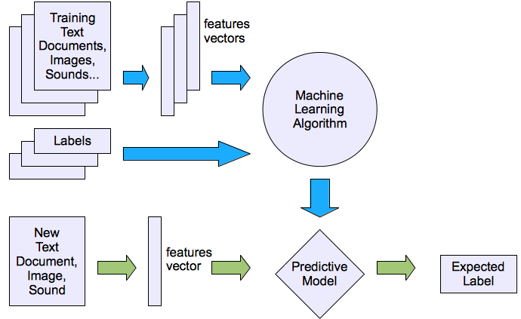
Supervised Learning

Slide 9
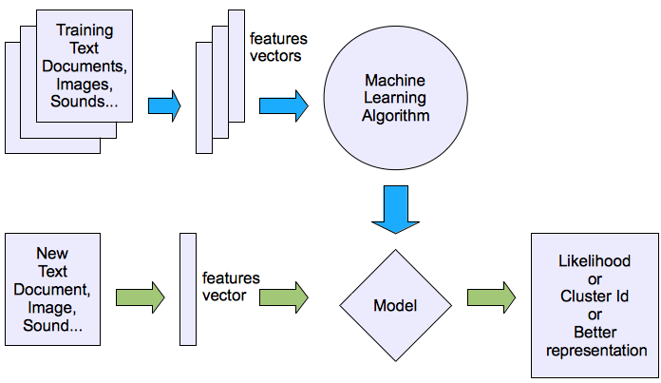
Unsupervised learning

Slide 10
Issues in Machine Learning
What algorithms can approximate functions well and when?
How does the number of training examples influence accuracy?
How does the complexity of hypothesis representation impact it?
How does noisy data influence accuracy?
What are the theoretical limits of learnability?
How can prior knowledge of learner help?
How can systems alter their own representation?
What clues can we get from biological learning systems?

Slide 11
Machine Learning
How use a model to make optimal decisions
Machine learning: how to acquire a model from data / experience
Learning parameters (e.g. probabilities)
Learning structure (e.g. BN graphs)
Learning hidden concepts (e.g. clustering)

Slide 12

Classification

Slide 13
Example: Spam Filter
Input: an email
Output: spam/ham
Setup:
Get a large collection of example emails, each labeled “spam” or “ham”
Note: someone has to hand label all this data!
Want to learn to predict labels of new, future emails
Features: The attributes used to make the ham / spam decision
Words: FREE!
Text Patterns: $dd, CAPS
Non-text: SenderInContacts
…
Dear Sir.
First, I must solicit your confidence in this transaction, this is by virture of its nature as being utterly confidencial and top secret. …
TO BE REMOVED FROM FUTURE MAILINGS, SIMPLY REPLY TO THIS MESSAGE AND PUT "REMOVE" IN THE SUBJECT.
99 MILLION EMAIL ADDRESSES
FOR ONLY $99
Ok, Iknow this is blatantly OT but I'm beginning to go insane. Had an old Dell Dimension XPS sitting in the corner and decided to put it to use, I know it was working pre being stuck in the corner, but when I plugged it in, hit the power nothing happened.

Slide 14
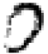
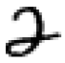

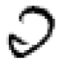
Example: Digit Recognition
Input: images / pixel grids
Output: a digit 0-9
Setup:
Get a large collection of example images, each labeled with a digit
Note: someone has to hand label all this data!
Want to learn to predict labels of new, future digit images
Features: The attributes used to make the digit decision
Pixels: (6,8)=ON
Shape Patterns: NumComponents, AspectRatio, NumLoops
…
0
1
2
1
??

Slide 15
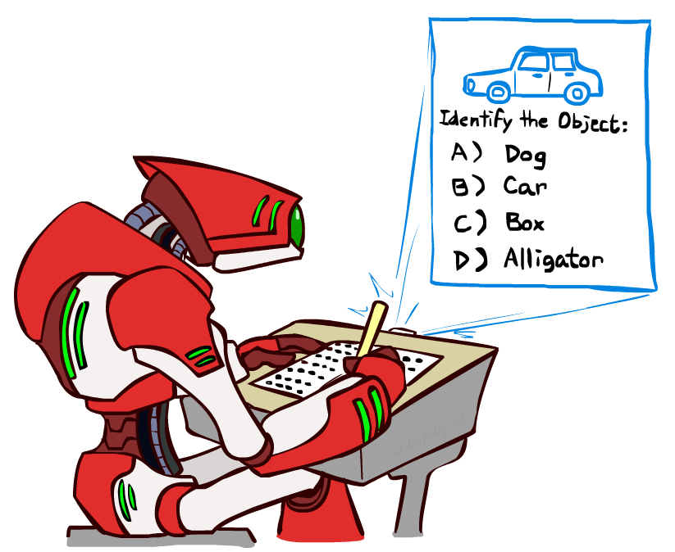
Other Classification Tasks
Classification: given inputs x, predict labels (classes) y
Examples:
Spam detection (input: document,
classes: spam / ham)
OCR (input: images, classes: characters)
Medical diagnosis (input: symptoms,
classes: diseases)
Automatic essay grading (input: document,
classes: grades)
Fraud detection (input: account activity,
classes: fraud / no fraud)
Customer service email routing
… many more
Classification is an important commercial technology!

Slide 16

Model-Based Classification

Slide 17
Model-Based Classification
Model-based approach
Build a model (e.g. Bayes’ net) where both the label and features are random variables
Instantiate any observed features
Query for the distribution of the label conditioned on the features
Challenges
What structure should the BN have?
How should we learn its parameters?

Slide 18

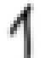
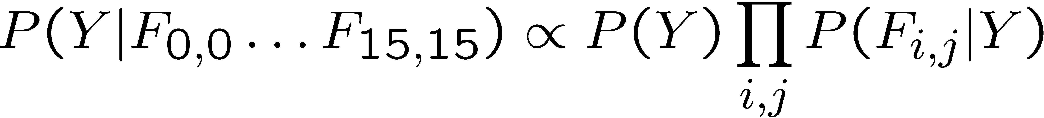
Naïve Bayes for Digits
Naïve Bayes: Assume all features are independent effects of the label
Simple digit recognition version:
One feature (variable) F_{ij} for each grid position <i,j>
Feature values are on / off, based on whether intensity
is more or less than 0.5 in underlying image
Each input maps to a feature vector, e.g.
Here: lots of features, each is binary valued
Naïve Bayes model:
What do we need to learn?
Y
F₁
F₂
F_{n}

Slide 19

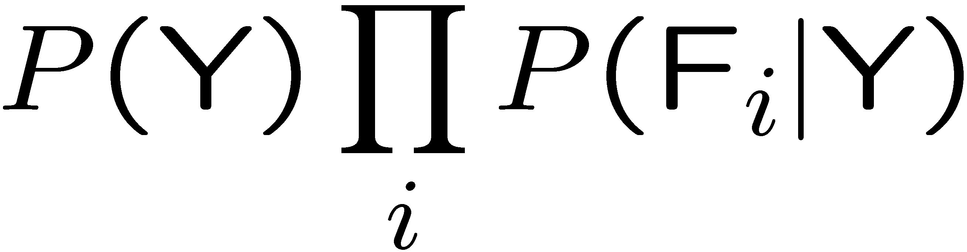
General Naïve Bayes
A general Naive Bayes model:
We only have to specify how each feature depends on the class
Total number of parameters is linear in n
Model is very simplistic, but often works anyway
Y
|Y| parameters
F₁
F₂
F_{n}
|Y| x |F|^{n} values
n x |F| x |Y| parameters

Slide 20
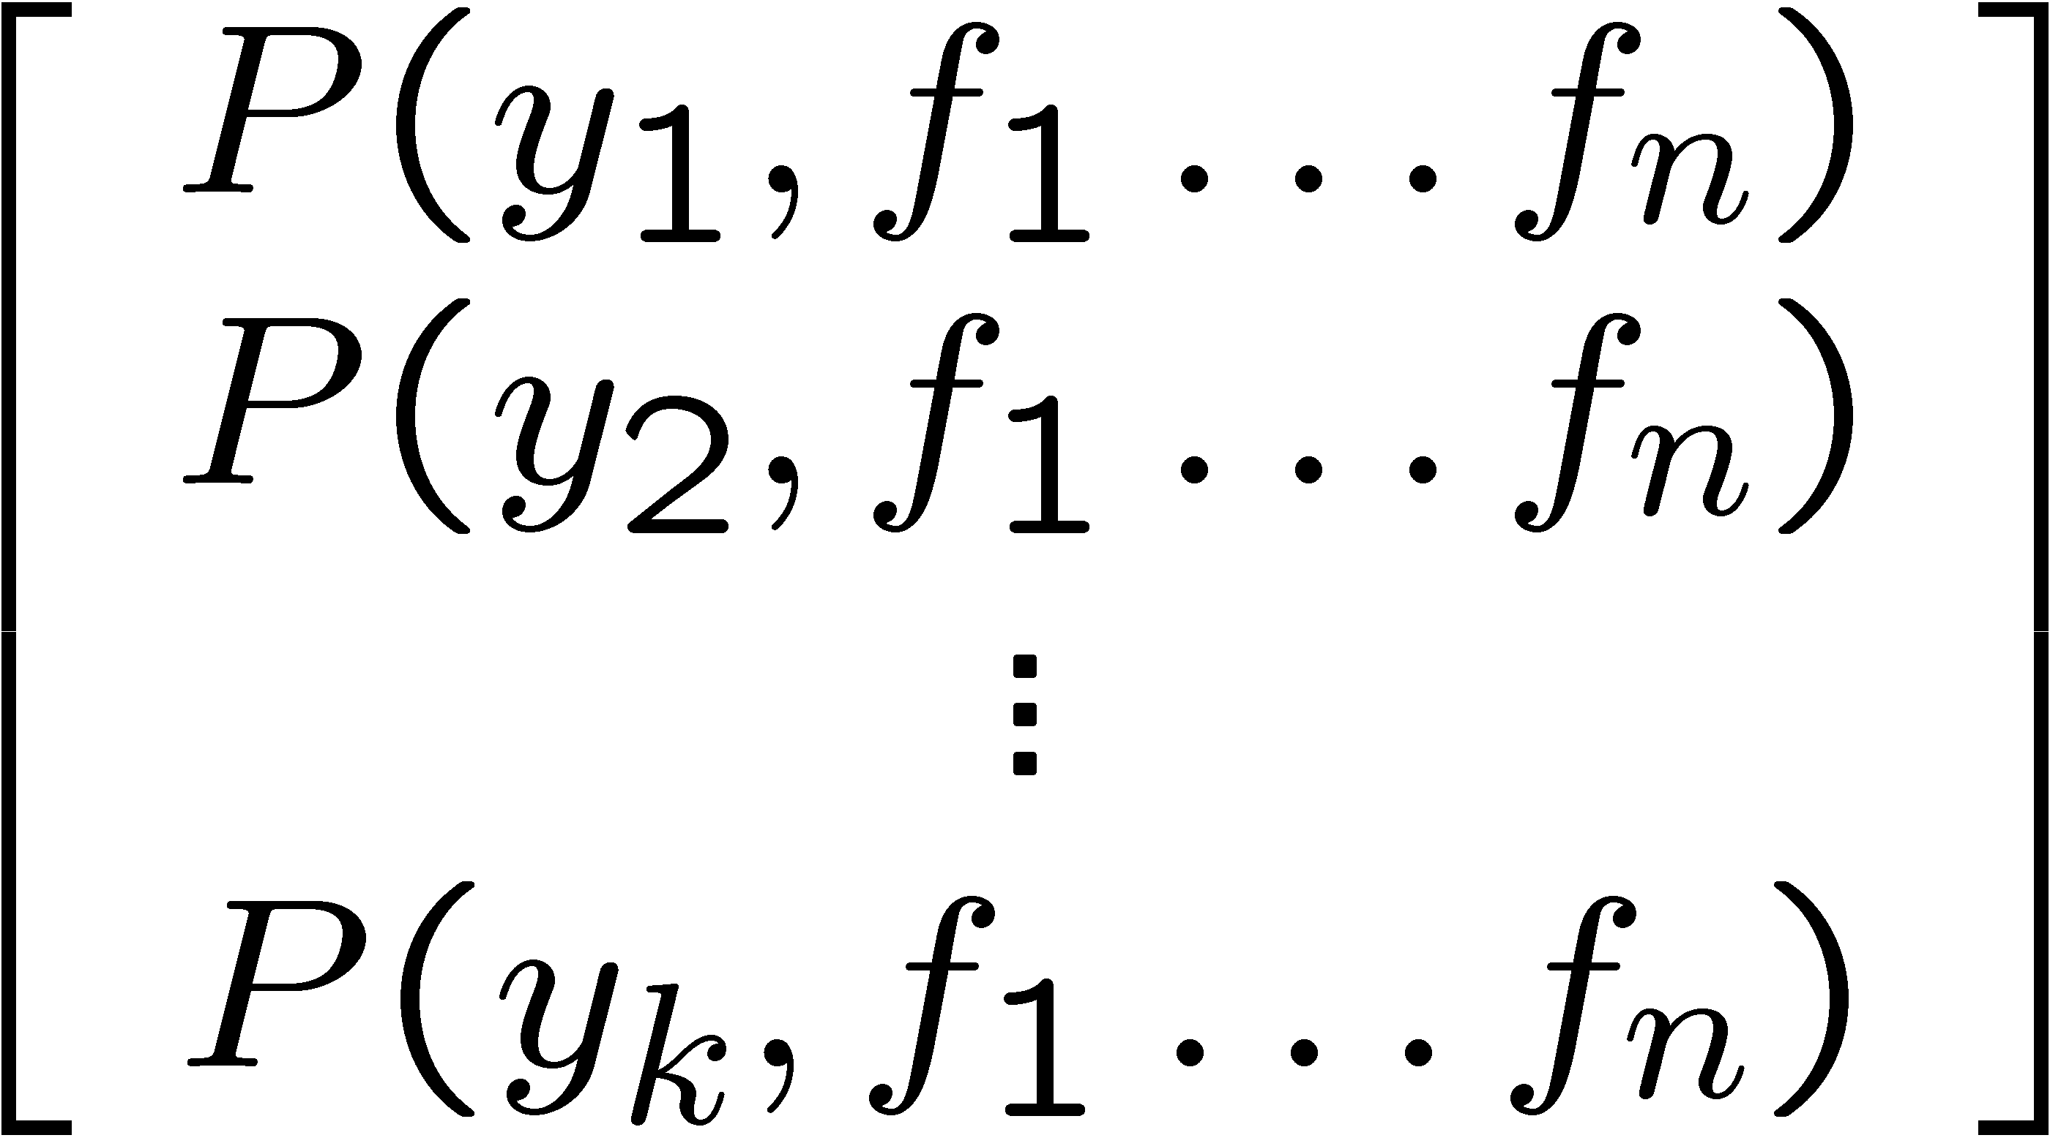
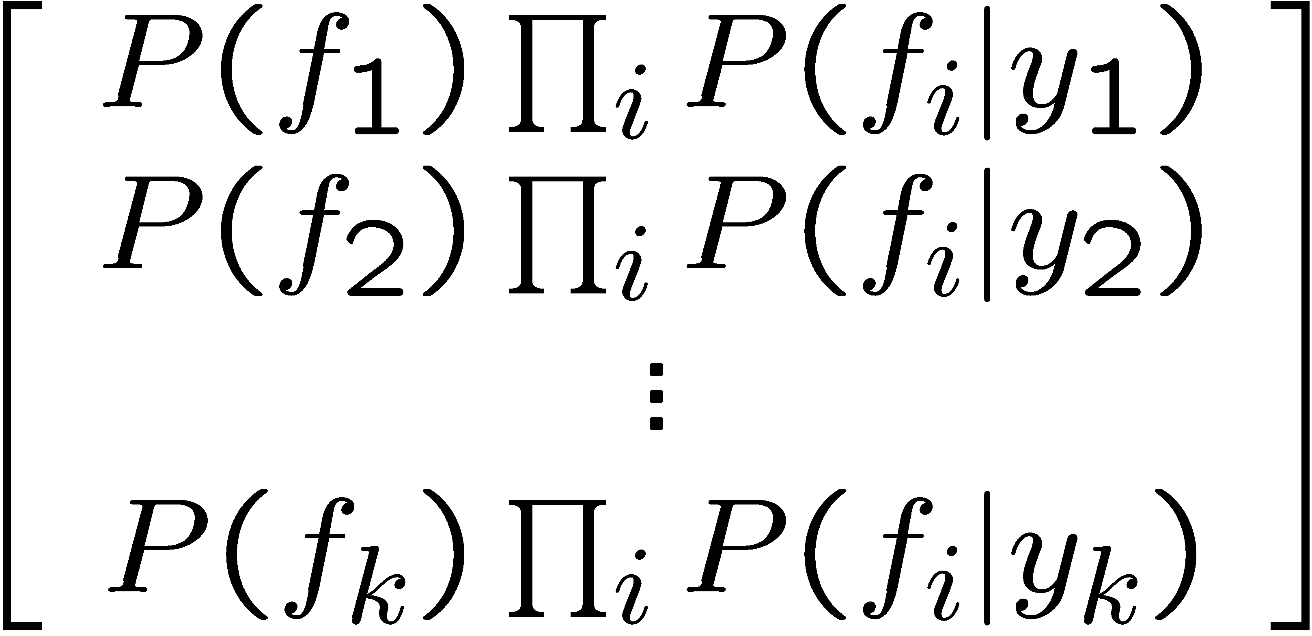

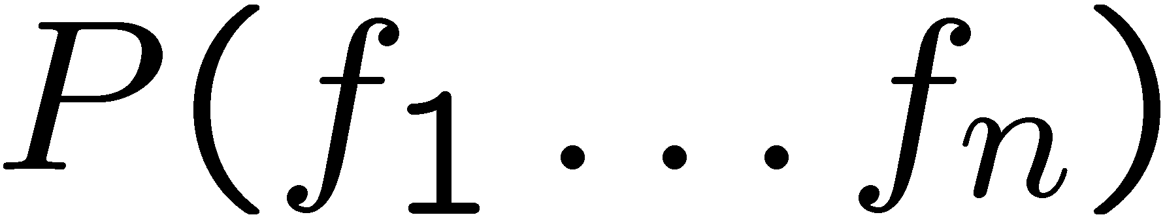
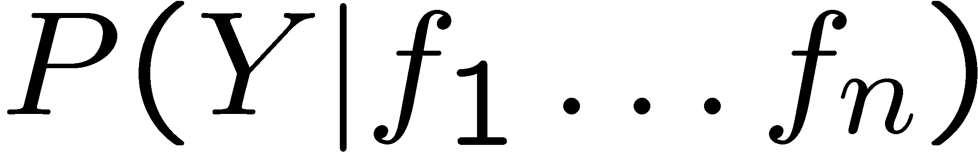
Inference for Naïve Bayes
Goal: compute posterior distribution over label variable Y
Step 1: get joint probability of label and evidence for each label
Step 2: sum to get probability of evidence
Step 3: normalize by dividing Step 1 by Step 2
+

Slide 21
General Naïve Bayes
What do we need in order to use Naïve Bayes?
Inference method (we just saw this part)
Start with a bunch of probabilities: P(Y) and the P(F_{i}|Y) tables
Use standard inference to compute P(Y|F₁…F_{n})
Nothing new here
Estimates of local conditional probability tables
P(Y), the prior over labels
P(F_{i}|Y) for each feature (evidence variable)
These probabilities are collectively called the parameters of the model and denoted by θ
Up until now, we assumed these appeared by magic, but…
…they typically come from training data counts: we’ll look at this soon

Slide 22
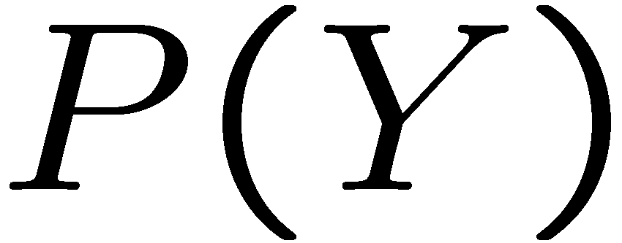
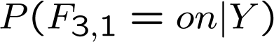
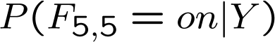
Example: Conditional Probabilities
1 | 0.1
2 | 0.1
3 | 0.1
4 | 0.1
5 | 0.1
6 | 0.1
7 | 0.1
8 | 0.1
9 | 0.1
0 | 0.1
1 | 0.01
2 | 0.05
3 | 0.05
4 | 0.30
5 | 0.80
6 | 0.90
7 | 0.05
8 | 0.60
9 | 0.50
0 | 0.80
1 | 0.05
2 | 0.01
3 | 0.90
4 | 0.80
5 | 0.90
6 | 0.90
7 | 0.25
8 | 0.85
9 | 0.60
0 | 0.80

Slide 23
A Spam Filter
Naïve Bayes spam filter
Data:
Collection of emails, labeled spam or ham
Note: someone has to hand label all this data!
Split into training, held-out, test sets
Classifiers
Learn on the training set
(Tune it on a held-out set)
Test it on new emails
Dear Sir.
First, I must solicit your confidence in this transaction, this is by virture of its nature as being utterly confidencial and top secret. …
TO BE REMOVED FROM FUTURE MAILINGS, SIMPLY REPLY TO THIS MESSAGE AND PUT "REMOVE" IN THE SUBJECT.
99 MILLION EMAIL ADDRESSES
FOR ONLY $99
Ok, Iknow this is blatantly OT but I'm beginning to go insane. Had an old Dell Dimension XPS sitting in the corner and decided to put it to use, I know it was working pre being stuck in the corner, but when I plugged it in, hit the power nothing happened.

Slide 24
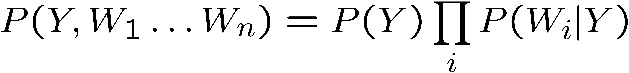
Naïve Bayes for Text
Bag-of-words Naïve Bayes:
Features: W_{i} is the word at positon i
As before: predict label conditioned on feature variables (spam vs. ham)
As before: assume features are conditionally independent given label
New: each W_{i} is identically distributed
Generative model:
“Tied” distributions and bag-of-words
Usually, each variable gets its own conditional probability distribution P(F|Y)
In a bag-of-words model
Each position is identically distributed
All positions share the same conditional probs P(W|Y)
Why make this assumption?
Called “bag-of-words” because model is insensitive to word order or reordering
how many variables are there?
how many values?
Word at position i, not i^{th} word in the dictionary!
When the lecture is over, remember to wake up the
person sitting next to you in the lecture room.
in is lecture lecture next over person remember room
sitting the the the to to up wake when you

Slide 25

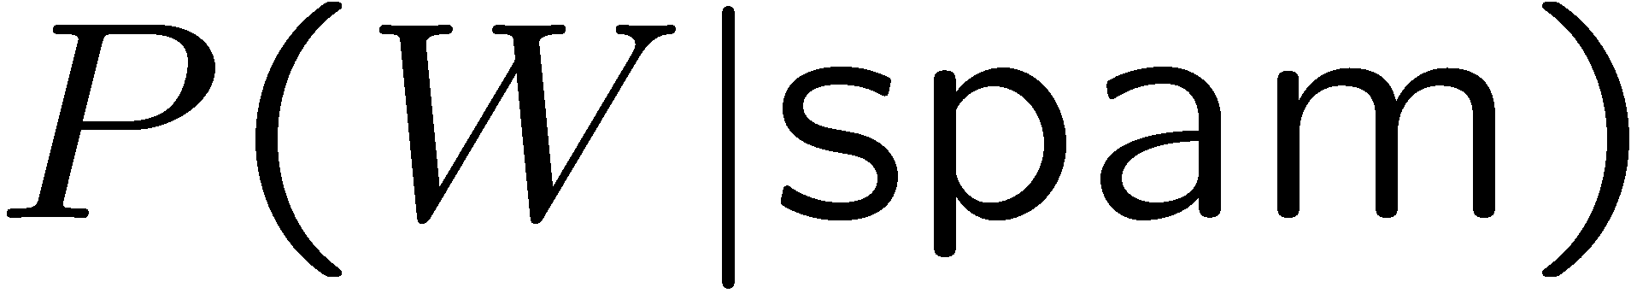
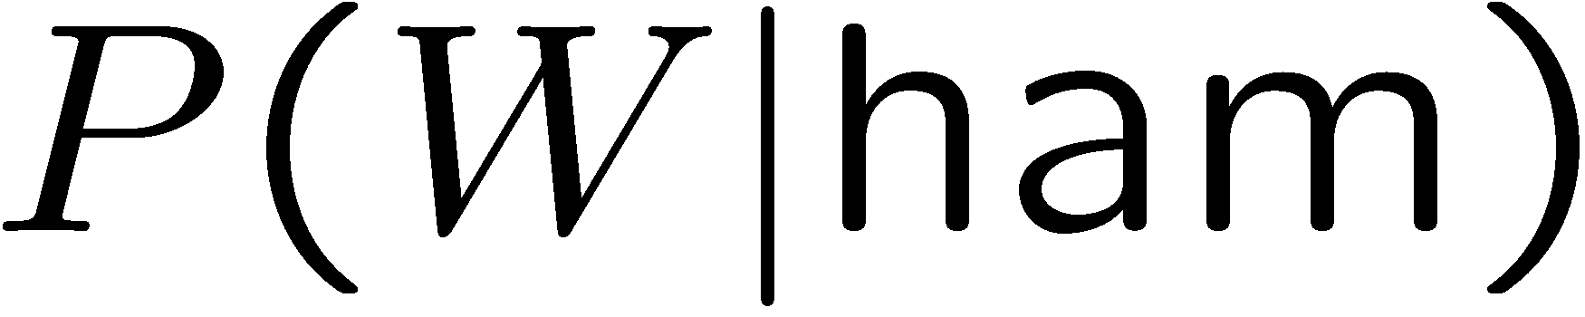
Example: Spam Filtering
Model:
What are the parameters?
Where do these tables come from?
ham : 0.66
spam: 0.33
the : 0.0156
to : 0.0153
and : 0.0115
of : 0.0095
you : 0.0093
a : 0.0086
with: 0.0080
from: 0.0075
...
the : 0.0210
to : 0.0133
of : 0.0119
2002: 0.0110
with: 0.0108
from: 0.0107
and : 0.0105
a : 0.0100
...

Slide 26
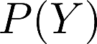
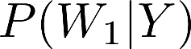
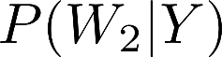
Spam Example
Word | P(w|spam) | P(w|ham) | Tot Spam | Tot Ham
(prior) | 0.33333 | 0.66666 | -1.1 | -0.4
Gary | 0.00002 | 0.00021 | -11.8 | -8.9
would | 0.00069 | 0.00084 | -19.1 | -16.0
you | 0.00881 | 0.00304 | -23.8 | -21.8
like | 0.00086 | 0.00083 | -30.9 | -28.9
to | 0.01517 | 0.01339 | -35.1 | -33.2
lose | 0.00008 | 0.00002 | -44.5 | -44.0
weight | 0.00016 | 0.00002 | -53.3 | -55.0
while | 0.00027 | 0.00027 | -61.5 | -63.2
you | 0.00881 | 0.00304 | -66.2 | -69.0
sleep | 0.00006 | 0.00001 | -76.0 | -80.5
P(spam | w) = 98.9

Slide 27
Naïve Bayes Classifier: Training Dataset
Class:
C1:buys_computer = ‘yes’
C2:buys_computer = ‘no’
Data to be classified:
X = (age <=30,
Income = medium,
Student = yes
Credit_rating = Fair)

Slide 35
Naïve Bayes Classifier: An Example
P(C_{i}): P(buys_computer = “yes”) = 9/14 = 0.643
P(buys_computer = “no”) = 5/14= 0.357
Compute P(X|C_{i}) for each class
P(age = “<=30” | buys_computer = “yes”) = 2/9 = 0.222
P(age = “<= 30” | buys_computer = “no”) = 3/5 = 0.6
P(income = “medium” | buys_computer = “yes”) = 4/9 = 0.444
P(income = “medium” | buys_computer = “no”) = 2/5 = 0.4
P(student = “yes” | buys_computer = “yes) = 6/9 = 0.667
P(student = “yes” | buys_computer = “no”) = 1/5 = 0.2
P(credit_rating = “fair” | buys_computer = “yes”) = 6/9 = 0.667
P(credit_rating = “fair” | buys_computer = “no”) = 2/5 = 0.4
X = (age <= 30 , income = medium, student = yes, credit_rating = fair)
P(X|C_{i}) : P(X|buys_computer = “yes”) = 0.222 x 0.444 x 0.667 x 0.667 = 0.044
P(X|buys_computer = “no”) = 0.6 x 0.4 x 0.2 x 0.4 = 0.019
P(X|C_{i})*P(C_{i}) : P(X|buys_computer = “yes”) * P(buys_computer = “yes”) = 0.028
P(X|buys_computer = “no”) * P(buys_computer = “no”) = 0.007
Therefore, X belongs to class (“buys_computer = yes”)

Slide 36
Avoiding the Zero-Probability Problem
Naïve Bayesian prediction requires each conditional prob. be non-zero. Otherwise, the predicted prob. will be zero
Ex. Suppose a dataset with 1000 tuples, income=low (0), income= medium (990), and income = high (10)
Use Laplacian correction (or Laplacian estimator)
Adding 1 to each case
Prob(income = low) = 1/1003
Prob(income = medium) = 991/1003
Prob(income = high) = 11/1003
The “corrected” prob. estimates are close to their “uncorrected” counterparts

Slide 37
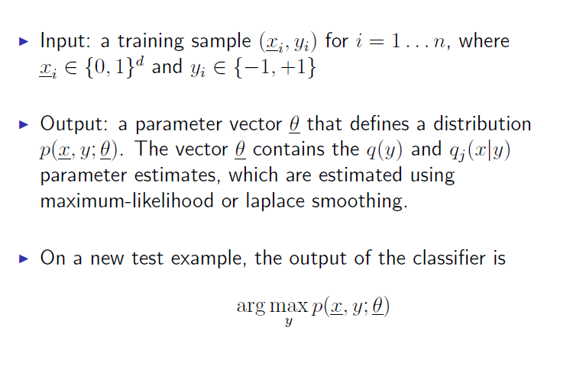
Naïve Bayes Summary

Slide 38
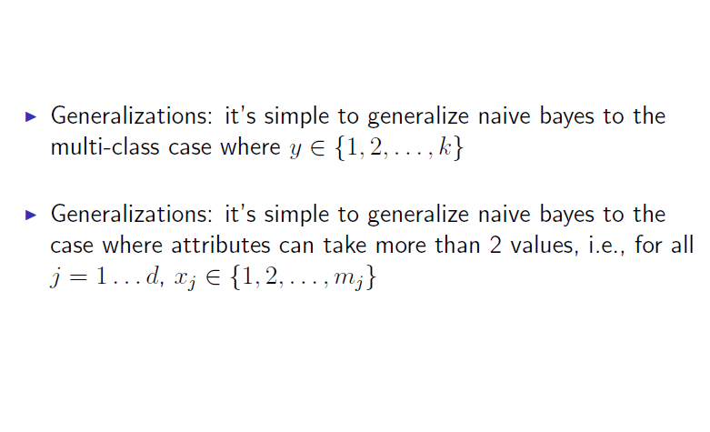
Naïve Bayes Generalization

Slide 39
Naïve Bayes Classifier: Comments
Advantages
Easy to implement
Good results obtained in most of the cases
Can deal with missing attributes some x_{j} is not observed
Disadvantages
Assumption: class conditional independence, therefore loss of accuracy
Practically, dependencies exist among variables
E.g., hospitals: patients: Profile: age, family history, etc.
Symptoms: fever, cough etc., Disease: lung cancer, diabetes, etc.
Dependencies among these cannot be modeled by Naïve Bayes Classifier
How to deal with these dependencies? Bayesian Belief Networks

Slide 40
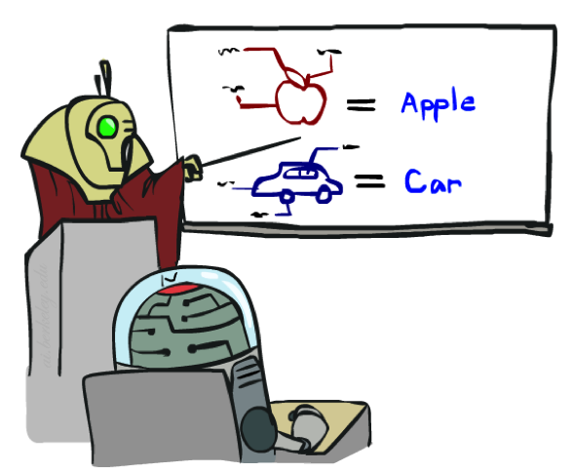


Training and Testing

Slide 41



Important Concepts
Data: labeled instances, e.g. emails marked spam/ham
Training set
Held out set
Test set
Features: attribute-value pairs which characterize each x
Experimentation cycle
Learn parameters (e.g. model probabilities) on training set
(Tune hyperparameters on held-out set)
Compute accuracy of test set
Very important: never “peek” at the test set!
Evaluation
Accuracy: fraction of instances predicted correctly
Overfitting and generalization
Want a classifier which does well on test data
Overfitting: fitting the training data very closely, but not generalizing well
Underfitting: fits the training set poorly
Training
Data
Held-Out
Data
Test
Data

Slide 42



Underfitting and Overfitting

Slide 43
Overfitting
30
25
20
Degree 15 polynomial
15
10
5
0
-5
-10
-15
0
2
4
6
8
10
12
14
16
18
20

Slide 44
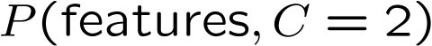
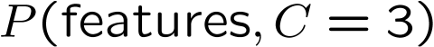
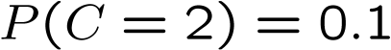
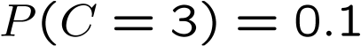
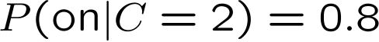
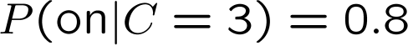
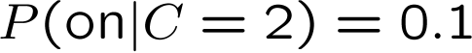
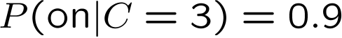
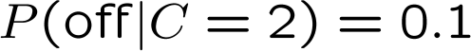
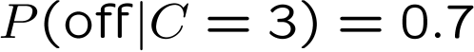
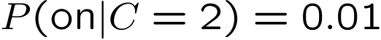
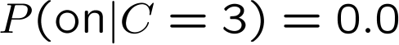
Example: Overfitting
2 wins!!

Slide 45
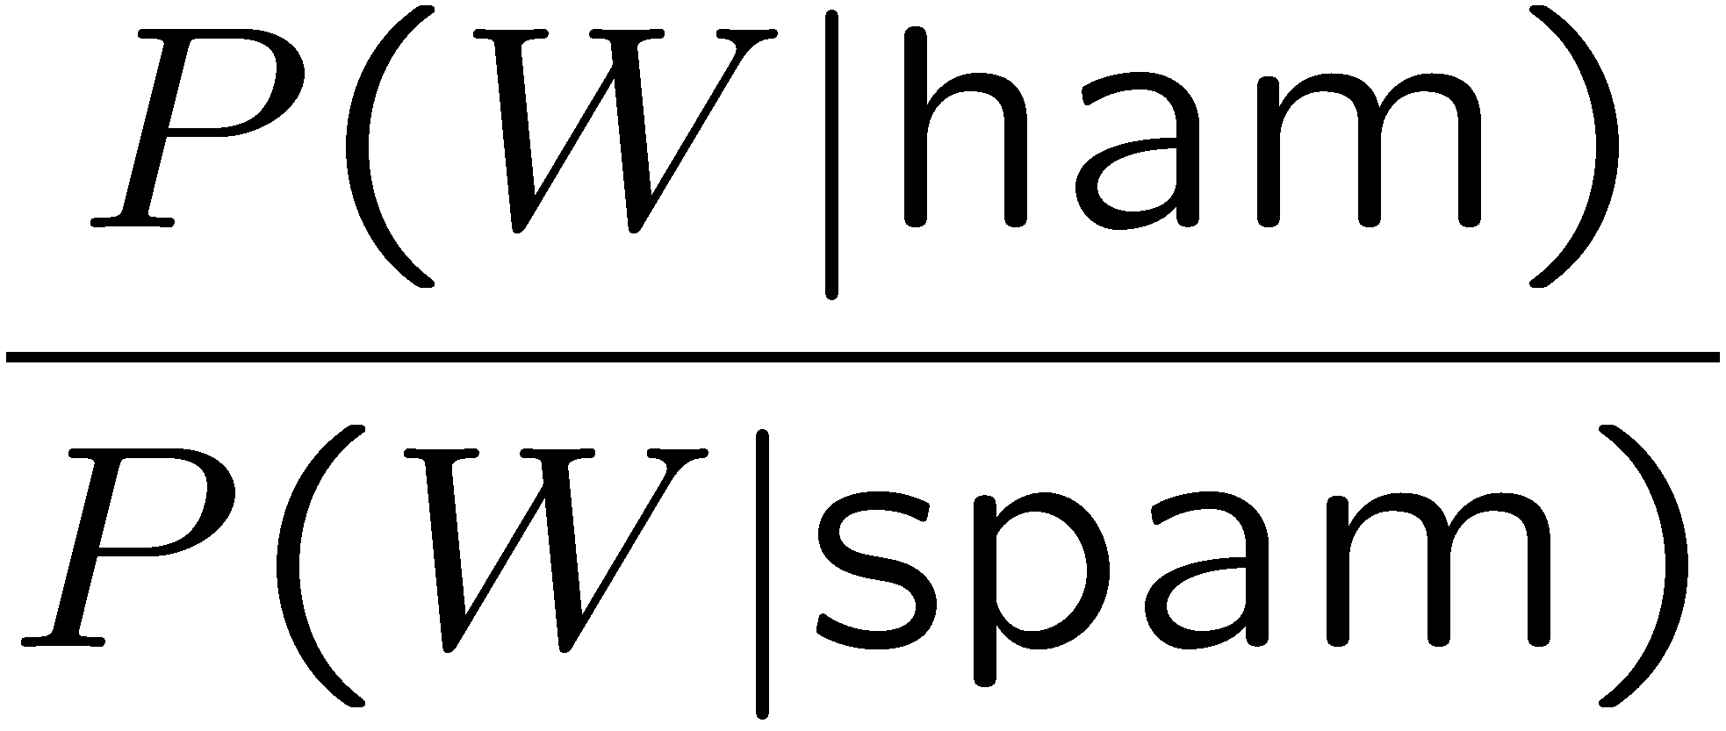
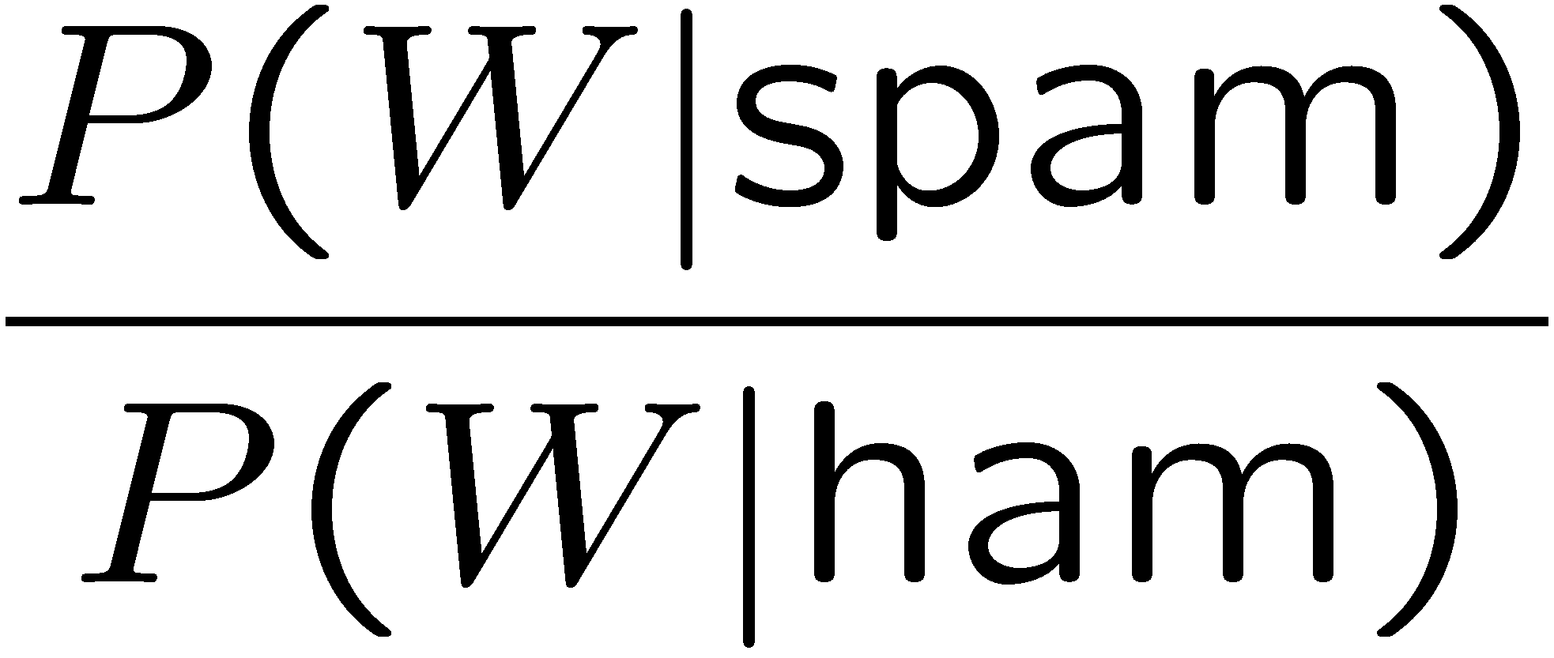
Example: Overfitting
Posteriors determined by relative probabilities (odds ratios):
south-west : inf
nation : inf
morally : inf
nicely : inf
extent : inf
seriously : inf
...
screens : inf
minute : inf
guaranteed : inf
$205.00 : inf
delivery : inf
signature : inf
...
What went wrong here?

Slide 46
Generalization and Overfitting
Relative frequency parameters will overfit the training data!
Just because we never saw a 3 with pixel (15,15) on during training doesn’t mean we won’t see it at test time
Unlikely that every occurrence of “minute” is 100% spam
Unlikely that every occurrence of “seriously” is 100% ham
What about all the words that don’t occur in the training set at all?
In general, we can’t go around giving unseen events zero probability
As an extreme case, imagine using the entire email as the only feature
Would get the training data perfect (if deterministic labeling)
Wouldn’t generalize at all
Just making the bag-of-words assumption gives us some generalization, but isn’t enough
To generalize better: we need to smooth or regularize the estimates

Slide 47
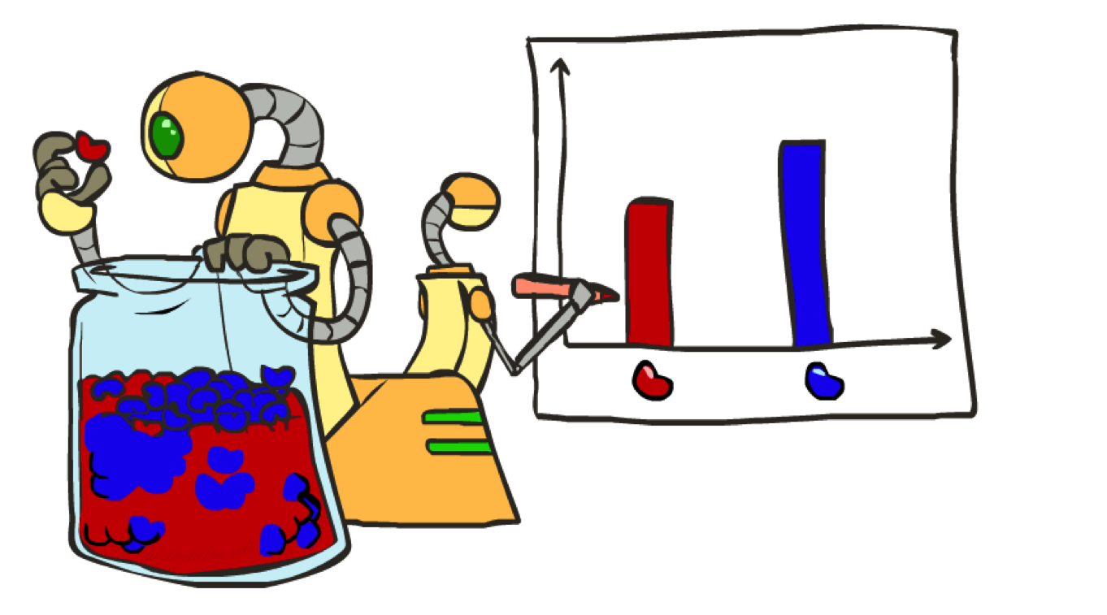
Parameter Estimation

Slide 48
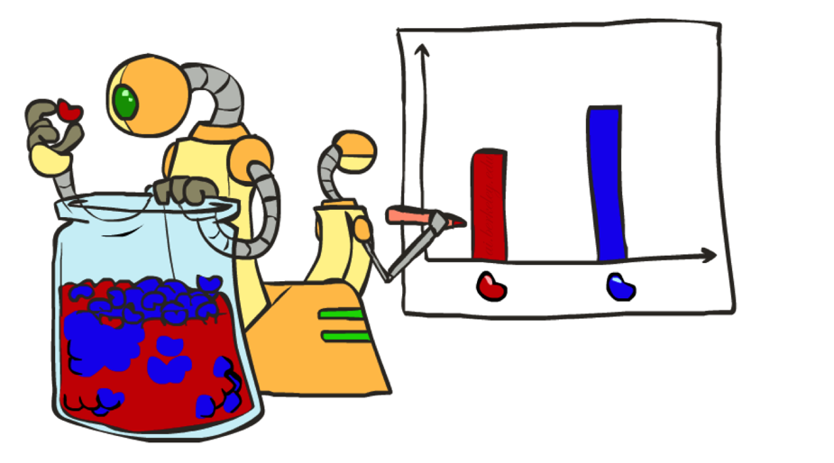
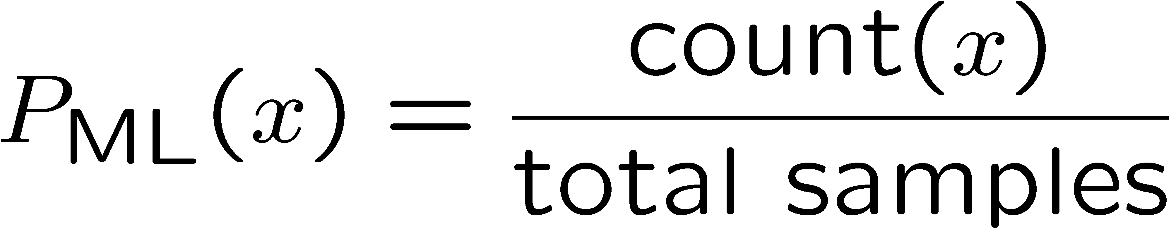
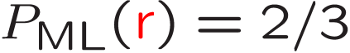
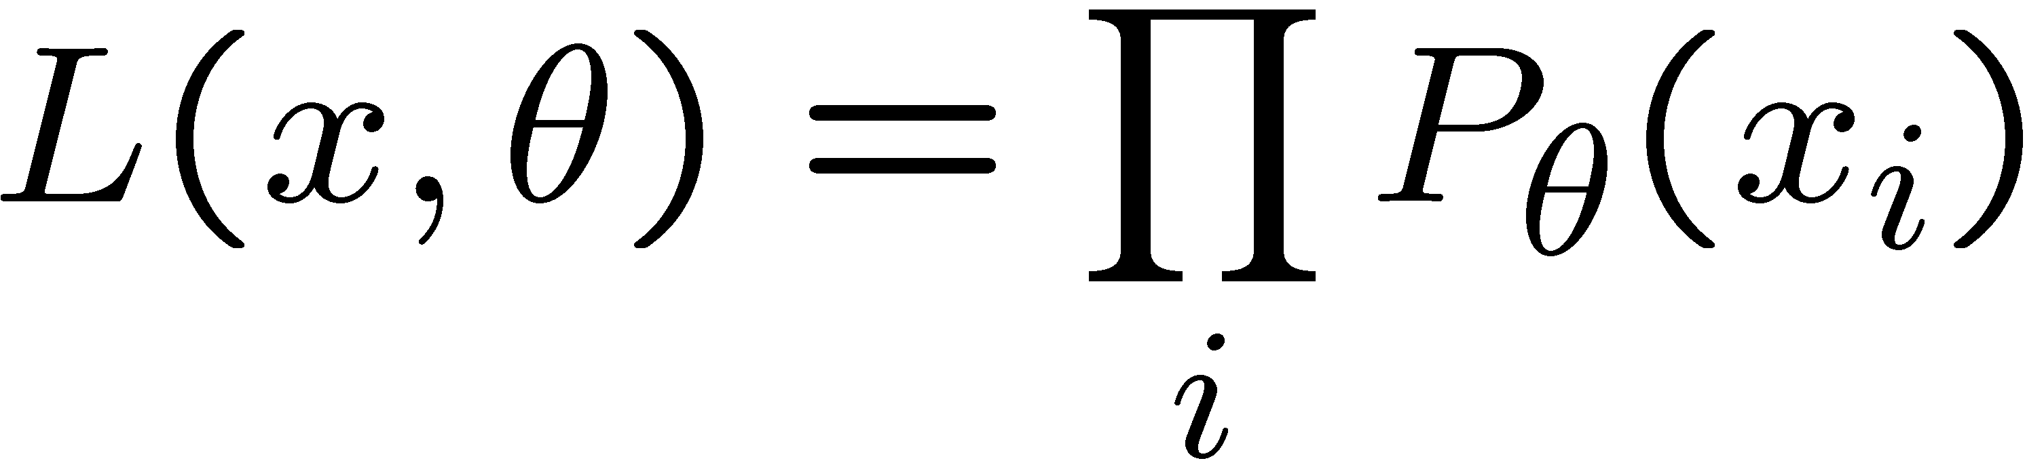
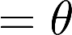
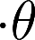
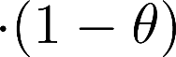
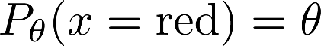
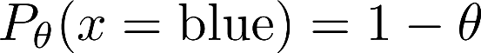
Parameter Estimation
Estimating the distribution of a random variable
Elicitation: ask a human (why is this hard?)
Empirically: use training data (learning!)
E.g.: for each outcome x, look at the empirical rate of that value:
This is the estimate that maximizes the likelihood of the data
r
b
b
b
r
r
b
b
b
r
r
b
b
b
b
r
r
b

Slide 49
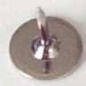


Your First Consulting Job
A billionaire tech entrepreneur asks you a question:
He says: I have thumbtack, if I flip it, what’s the probability it will fall with the nail up?
You say: Please flip it a few times:
You say: The probability is:
P(H) = 3/5
He says: Why???
You say: Because…

Slide 50
Your First Consulting Job
P(Heads) = θ, P(Tails) = 1-θ
Flips are i.i.d.:
Independent events
Identically distributed according to unknown distribution
Sequence D of α_{H} Heads and α_{T} Tails
…
D={x_{i} | i=1…n}, P(D | θ ) = Π_{i}P(x_{i} | θ )

Slide 51

Maximum Likelihood Estimation
Data: Observed set D of α_{H} Heads and α_{T} Tails
Hypothesis space: Binomial distributions
Learning: finding θ is an optimization problem
What’s the objective function?
MLE: Choose θ to maximize probability of D

Slide 52


Maximum Likelihood Estimation
Set derivative to zero, and solve!

Slide 53

Smoothing

Slide 54





Maximum Likelihood?
Relative frequencies are the maximum likelihood estimates
Another option is to consider the most likely parameter value given the data
????

Slide 55


Unseen Events

Slide 56




Laplace Smoothing
Laplace’s estimate:
Pretend you saw every outcome once more than you actually did
Can derive this estimate with Dirichlet priors (see cs281a)
r
r
b

Slide 57


Slide 58
Decision trees

Slide 59
Inductive inference with decision trees
Decision Trees is one of the most widely used and practical methods of inductive inference
Features
Method for approximating discrete-valued functions (including boolean)
Learned functions are represented as decision trees (or if-then-else rules)
Expressive hypotheses space, including disjunction
Robust to noisy data

Slide 60

Decision tree representation (PlayTennis)
⟨Outlook=Sunny, Temp=Hot, Humidity=High, Wind=Strong⟩ No
Notes:
Each node represents a test on an attribute of the instance to be classified and each outgoing arch a possible outcome, leading to a further test.
The leafs correspond to classification actions. A binary classification in this case.
The instance <Outlook=Sunny, Temp=Hot, Humidity=High, Wind=Strong> is classified as No.

Slide 61
Decision trees expressivity
Decision trees represent a disjunction of conjunctions on constraints on the value of attributes:
(Outlook = Sunny ∧ Humidity = Normal) ∨
(Outlook = Overcast) ∨
(Outlook = Rain ∧ Wind = Weak)

Slide 62

Decision trees representation
+
−
Notes:
The notation [n+, m-] means n positive examples and m negative examples
Un sistema esperto per decidere quando è necessario un taglio cesareo.

Slide 63
When to use Decision Trees
Problem characteristics:
Instances can be described by attribute value pairs
Target function is discrete valued
Disjunctive hypothesis may be required
Possibly noisy training data samples
Robust to errors in training data
Missing attribute values
Different classification problems:
Equipment or medical diagnosis
Credit risk analysis
Several tasks in natural language processing

Slide 64
Top-down induction of Decision Trees
ID3 (Quinlan, 1986) is a basic algorithm for learning DT's
Given a training set of examples, the algorithms for building DT performs search in the space of decision trees
The construction of the tree is top-down. The algorithm is greedy.
The fundamental question is “which attribute should be tested next? Which question gives us more information?”
Select the best attribute
A descendent node is then created for each possible value of this attribute and examples are partitioned according to this value
The process is repeated for each successor node until all the examples are classified correctly or there are no attributes left

Slide 65

Which attribute is the best classifier?
A statistical property called information gain, measures how well a given attribute separates the training examples
Information gain uses the notion of entropy, commonly used in information theory
Information gain = expected reduction of entropy

Slide 66
Entropy in binary classification
Entropy measures the impurity of a collection of examples. It depends from the distribution of the random variable p.
S is a collection of training examples
p₊ the proportion of positive examples in S
p– the proportion of negative examples in S
Entropy (S) ≡ – p₊ log₂ p₊ – p–log₂ p– [0 log₂0 = 0]
Entropy ([14+, 0–]) = – 14/14 log₂ (14/14) – 0 log₂ (0) = 0
Entropy ([9+, 5–]) = – 9/14 log₂ (9/14) – 5/14 log₂ (5/14) = 0,94
Entropy ([7+, 7– ]) = – 7/14 log₂ (7/14) – 7/14 log₂ (7/14) =
= 1/2 + 1/2 = 1 [log₂1/2 = – 1]
Note: the log of a number < 1 is negative, 0 ≤ p ≤ 1, 0 ≤ entropy ≤ 1
Notes:
S=[9+, 5-] una collezione di esempi di cui 9 positivi e 5 negativi

Slide 67

Entropy
Notes:
Plot di come varia l’entropia al crescere della proporzione degli esempi positivi.

Slide 68
Entropy in general
Entropy measures the amount of information in a random variable
H(X) = – p₊ log₂ p₊ – p– log₂ p– X = {+, –}
for binary classification [two-valued random variable]
c c
H(X) = – Σ p_{i} log₂ p_{i} = Σ p_{i} log₂ 1/ p_{i} X = {i, …, c}
i=1 i=1
for classification in c classes
Example: rolling a die with 8, equally probable, sides
8
H(X) = – Σ 1/8 log₂ 1/8 = – log₂ 1/8 = log₂ 8 = 3
i=1

Slide 69
Information gain as entropy reduction
Information gain is the expected reduction in entropy caused by partitioning the examples on an attribute.
The higher the information gain the more effective the attribute in classifying training data.
Expected reduction in entropy knowing A
Gain(S, A) = Entropy(S) − Σ Entropy(Sv)
v ∈ Values(A)
Values(A) possible values for A
Sv subset of S for which A has value v
|Sv|
|S|
Notes:
La riduzione in entropia attesa partizionando sui valori dell’ attributo A

Slide 70
Example: expected information gain
Let
Values(Wind) = {Weak, Strong}
S = [9+, 5−]
S_{Weak} = [6+, 2−]
S_{Strong} = [3+, 3−]
Information gain due to knowing Wind:
Gain(S, Wind) = Entropy(S) − 8/14 Entropy(S_{Weak}) − 6/14 Entropy(S_{Strong})
= 0,94 − 8/14 × 0,811 − 6/14 × 1,00
= 0,048

Slide 71

Which attribute is the best classifier?

Slide 72

Example
Notes:
Target attrbute = playtennis

Slide 76
First step: which attribute to test at the root?
Which attribute should be tested at the root?
Gain(S, Outlook) = 0.246
Gain(S, Humidity) = 0.151
Gain(S, Wind) = 0.084
Gain(S, Temperature) = 0.029
Outlook provides the best prediction for the target
Lets grow the tree:
add to the tree a successor for each possible value of Outlook
partition the training samples according to the value of Outlook

Slide 77

After first step

Slide 79
Example
Notes:
Target attrbute = playtennis

Slide 81
Second step
Working on Outlook=Sunny node:
Gain(S_{Sunny}, Humidity) = 0.970 − 3/5 × 0.0 − 2/5 × 0.0 = 0.970
Gain(S_{Sunny}, Wind) = 0.970 − 2/5 × 1.0 − 3.5 × 0.918 = 0 .019
Gain(S_{Sunny}, Temp.) = 0.970 − 2/5 × 0.0 − 2/5 × 1.0 − 1/5 × 0.0 = 0.570
Humidity provides the best prediction for the target
Lets grow the tree:
add to the tree a successor for each possible value of Humidity
partition the training samples according to the value of Humidity

Slide 82


Second and third steps
{D1, D2, D8}
No
{D9, D11}
Yes
{D4, D5, D10}
Yes
{D6, D14}
No

Slide 83
ID3: algorithm
ID3(X, T, Attrs) X: training examples:
T: target attribute (e.g. PlayTennis),
Attrs: other attributes, initially all attributes
Create Root node
If all X's are +, return Root with class +
If all X's are –, return Root with class –
If Attrs is empty return Root with class most common value of T in X
else
A ← best attribute; decision attribute for Root ← A
For each possible value v_{i} of A:
- add a new branch below Root, for test A = v_{i}
- X_{i} ← subset of X with A = v_{i}
- If X_{i} is empty then add a new leaf with class the most common value of T in X
else add the subtree generated by ID3(X_{i}, T, Attrs − {A})
return Root

Slide 84

Search space in Decision Tree learning
The search space is made by partial decision trees
The algorithm is hill-climbing
The evaluation function is information gain
The hypotheses space is complete (represents all discrete-valued functions)
The search maintains a single current hypothesis
No backtracking; no guarantee of optimality
It uses all the available examples (not incremental)
May terminate earlier, accepting noisy classes

Slide 85
Inductive bias in decision tree learning
Inductive Bias: The inductive bias (also known as learning bias) of a learning algorithm is the set of assumptions that the learner uses to predict outputs given inputs that it has not encountered.
What is the inductive bias of DT learning?
Shorter trees are preferred over longer trees
Not enough. This is the bias exhibited by a simple breadth first algorithm generating all DT's selecting the shorter one
Prefer trees that place high information gain attributes close to the root
Note: DT's are not limited in representing all possible functions

Slide 86
Two kinds of biases
Preference or search biases (due to the search strategy)
ID3 searches a complete hypotheses space; the search strategy is incomplete
Restriction or language biases (due to the set of hypotheses expressible or considered)
Candidate-Elimination searches an incomplete hypotheses space; the search strategy is complete
A combination of biases in learning a linear combination of weighted features in board games.

Slide 87
Prefer shorter hypotheses: Occam's rasor
Why prefer shorter hypotheses?
Arguments in favor:
There are fewer short hypotheses than long ones
If a short hypothesis fits data unlikely to be a coincidence
Elegance and aesthetics
Arguments against:
Not every short hypothesis is a reasonable one.
Occam's razor:"The simplest explanation is usually the best one."
a principle usually (though incorrectly) attributed14th-century English logician and Franciscan friar, William of Ockham.
lex parsimoniae ("law of parsimony", "law of economy", or "law of succinctness")
The term razor refers to the act of shaving away unnecessary assumptions to get to the simplest explanation.

Slide 88
Issues in decision trees learning
Overfitting
Reduced error pruning
Rule post-pruning
Extensions
Continuous valued attributes
Alternative measures for selecting attributes
Handling training examples with missing attribute values
Handling attributes with different costs
Improving computational efficiency
Most of these improvements in C4.5 (Quinlan, 1993)
Notes:
L'overfitting può succedere quando c' è rumore nei dati.

Slide 89
Overfitting: definition
Building trees that “adapt too much” to the training examples may lead to “overfitting”.
Consider error of hypothesis h over
training data: error_{D}(h) empirical error
entire distribution X of data: error_{X}(h) expected error
Hypothesis h overfits training data if there is an alternative hypothesis h' ∈ H such that
error_{D}(h) < error_{D}(h’) and
error_{X}(h’) < error_{X}(h)
i.e. h’ behaves better over unseen data
Notes:
L' errore sul training e' minore e quindi ci appare come la migliore ipotesi
Ma l' errore nello spazio di tutti I possibili dati è maggiore.

Slide 90
Example
D15 Sunny Hot Normal Strong No
Notes:
L’ esempio D15 è sbagliato, introduce rumore nei dati.

Slide 91

Overfitting in decision trees
⟨Outlook=Sunny, Temp=Hot, Humidity=Normal, Wind=Strong, PlayTennis=No ⟩
New noisy example causes splitting of second leaf node.
Notes:
The example shows that noise can lead to overfitting.
Overfitting without noise is also possible, especially when classifcation decision on the leafs are based on few examples. Uniform classification may be a coincidence.
This is a potential cause of overfitting.
Overfitting is a significant problem for DT, reducing the accuracy to 10-25% on many problems.

Slide 92

Overfitting in decision tree learning
Notes:
ID3 is used to learn which medical patients have a form of diabetes.
Horizontal axis reports number of nodes in the tree
Vertical axis the accuracy of the prediction
The accuracy on the training keeps growing while accuracy on the test data grows up to trees with 25 node then starts decreasing.

Slide 93
Avoid overfitting in Decision Trees
Two strategies:
Stop growing the tree earlier, before perfect classification
Allow the tree to overfit the data, and then post-prune the tree
Training and validation set
split the training in two parts (training and validation) and use validation to assess the utility of post-pruning
Reduced error pruning
Rule pruning
Other approaches
Use a statistical test to estimate effect of expanding or pruning
Minimum description length principle: uses a measure of complexity of encoding the DT and the examples, and halt growing the tree when this encoding size is minimal
Notes:
Usando tutti dati di training, un test statistico può predire l’ influenza delle decisioni se espandere (o potare) sulle prestazioni su tutto X.
Minimum description length principle, un principio di compattezza della rappresentazione.

Slide 94
Reduced-error pruning (Quinlan 1987)
Each node is a candidate for pruning
Pruning consists in removing a subtree rooted in a node: the node becomes a leaf and is assigned the most common classification
Nodes are removed only if the resulting tree performs no worse on the validation set.
Nodes are pruned iteratively: at each iteration the node whose removal most increases accuracy on the validation set is pruned.
Pruning stops when no pruning increases accuracy
Notes:
Potatura sulla base di errori ridotti, valutati sul validation set.

Slide 95

Effect of reduced error pruning
Notes:
The new line shows accuracy on test data

Slide 96
Rule post-pruning
Create the decision tree from the training set
Convert the tree into an equivalent set of rules
Each path corresponds to a rule
Each node along a path corresponds to a pre-condition
Each leaf classification to the post-condition
Prune (generalize) each rule by removing those preconditions whose removal improves accuracy …
… over validation set
… over training with a pessimistic, statistically inspired, measure
Sort the rules in estimated order of accuracy, and consider them in sequence when classifying new instances

Slide 97

Converting to rules
(Outlook=Sunny)∧(Humidity=High) ⇒ (PlayTennis=No)

Slide 98
Why converting to rules?
Each distinct path produces a different rule: a condition removal may be based on a local (contextual) criterion. Node pruning is global and affects all the rules
In rule form, tests are not ordered and there is no book-keeping involved when conditions (nodes) are removed
Converting to rules improves readability for humans

Slide 99
Dealing with continuous-valued attributes
So far discrete values for attributes and for outcome.
Given a continuous-valued attribute A, dynamically create a new attribute A_{c}
A_{c} = True if A < c, False otherwise
How to determine threshold value c ?
Example. Temperature in the PlayTennis example
Sort the examples according to Temperature
Temperature 40 48 | 60 72 80 | 90
PlayTennis No No 54 Yes Yes Yes 85 No
Determine candidate thresholds by averaging consecutive values where there is a change in classification: (48+60)/2=54 and (80+90)/2=85
Evaluate candidate thresholds (attributes) according to information gain. The best is Temperature_{>54}.The new attribute competes with the other ones

Slide 100
Problems with information gain
Natural bias of information gain: it favours attributes with many possible values.
Consider the attribute Date in the PlayTennis example.
Date would have the highest information gain since it perfectly separates the training data.
It would be selected at the root resulting in a very broad tree
Very good on the training, this tree would perform poorly in predicting unknown instances. Overfitting.
The problem is that the partition is too specific, too many small classes are generated.
We need to look at alternative measures …

Slide 101
An alternative measure: gain ratio
c |S_{i} | |S_{i} |
SplitInformation(S, A) ≡ − Σ log₂ i=1 |S | |S |
S_{i} are the sets obtained by partitioning on value i of A
SplitInformation measures the entropy of S with respect to the values of A. The more uniformly dispersed the data the higher it is.
Gain(S, A)
GainRatio(S, A) ≡
SplitInformation(S, A)
GainRatio penalizes attributes that split examples in many small classes such as Date. Let |S |=n, Date splits examples in n classes
SplitInformation(S, Date)= −[(1/n log₂ 1/n)+…+ (1/n log₂ 1/n)]= −log₂1/n =log₂n
Compare with A, which splits data in two even classes:
SplitInformation(S, A)= − [(1/2 log₂1/2)+ (1/2 log₂1/2) ]= − [− 1/2 −1/2]=1
Notes:
2^{-x} = 1/2^{x}

Slide 102
Adjusting gain-ratio
Problem: SplitInformation(S, A) can be zero or very small when |S_{i} | ≈ |S | for some value i
To mitigate this effect, the following heuristics has been used:
compute Gain for each attribute
apply GainRatio only to attributes with Gain above average
Other measures have been proposed:
Distance-based metric [Lopez-De Mantaras, 1991] on the partitions of data
Each partition (induced by an attribute) is evaluated according to the distance to the partition that perfectly classifies the data.
The partition closest to the ideal partition is chosen
Notes:
Caso limite |S1|=0 |S2|=n
SplitInformation = - [0/n * log 0/n + n/n * log n/n] = - 0 - 0 = 0
GainRatio indefinito

Slide 103
Handling incomplete training data
How to cope with the problem that the value of some attribute may be missing?
Example: Blood-Test-Result in a medical diagnosis problem
The strategy: use other examples to guess attribute
Assign the value that is most common among the training examples at the node
Assign a probability to each value, based on frequencies, and assign values to missing attribute, according to this probability distribution
Missing values in new instances to be classified are treated accordingly, and the most probable classification is chosen (C4.5)

Slide 104
Handling attributes with different costs
Instance attributes may have an associated cost: we would prefer decision trees that use low-cost attributes
ID3 can be modified to take into account costs:
Tan and Schlimmer (1990)
Gain²(S, A)
Cost(S, A)
Nunez (1988)
2^{Gain(S, A)} − 1
(Cost(A) + 1)^{w} _{w ∈ [0,1]}

Slide 108

A Simple Neuron
An artificial neuron is a device with many inputs and one output.
The neuron has two modes of operation;
the training mode and
the using mode.

Slide 109
A Simple Neuron (Cont.)
In the training mode, the neuron can be trained to fire (or not), for particular input patterns.
In the using mode, when a taught input pattern is detected at the input, its associated output becomes the current output. If the input pattern does not belong in the taught list of input patterns, the firing rule is used to determine whether to fire or not.
The firing rule is an important concept in neural networks and accounts for their high flexibility. A firing rule determines how one calculates whether a neuron should fire for any input pattern. It relates to all the input patterns, not only the ones on which the node was trained on previously.

Slide 110
Neural Networks
A NN is a machine learning approach inspired by the way in which the brain performs a particular learning task:
Knowledge about the learning task is given in the form of examples.
Inter neuron connection strengths (weights) are used to store the acquired information (the training examples).
During the learning process the weights are modified in order to model the particular learning task correctly on the training examples.

Slide 111
When is neural network suitable?
Problems having following characteristics
Instances are available as many attribute-value pairs
Target function output may be discrete-valued, real-valued, or discrete-valued attributes
Errors in training example
Long training times are ok
Fast evaluation of the learned target function may be required
Ability of humans to understand the learned target function is not important

Slide 112
Learning
Supervised Learning
Recognizing hand-written digits, pattern recognition, regression.
Labeled examples (input , desired output)
Neural Network models: perceptron, feed-forward, radial basis function, support vector machine.
Unsupervised Learning
Find similar groups of documents in the web, content addressable memory, clustering.
Unlabeled examples (different realizations of the input alone)
Neural Network models: self organizing maps, Hopfield networks.

Slide 113
Network architectures
Three different classes of network architectures
single-layer feed-forward neurons are organized
multi-layer feed-forward in acyclic layers
recurrent
The architecture of a neural network is linked with the learning algorithm used to train

Slide 114
Single Layer Feed-forward
Input layer
of
source nodes
Output layer
of
neurons

Slide 115
Multi layer feed-forward
3-4-2 Network
Input
layer
Output
layer
Hidden Layer

Slide 116
Recurrent network
Recurrent Network with hidden neuron(s): unit delay operator z⁻¹ implies dynamic system
z⁻¹
input
hidden
output
z⁻¹
z⁻¹

Slide 117



Neural Network Architectures

Slide 118
The Neuron
The neuron is the basic information processing unit of a NN. It consists of:
A set of synapses or connecting links, each link characterized by a weight:
W₁, W₂, …, W_{m}
An adder function (linear combiner) which computes the weighted sum of the inputs:
Activation function (squashing function) for limiting the amplitude of the output of the neuron.

Slide 119
The Neuron
Bias
b
x₁
w₁
Activation
function
Local
Field
v
Output
y
Input
signal
x₂
w₂
Summing
function
x_{m}
w_{m}
Synaptic
weights

Slide 120
Bias of a Neuron
Bias b has the effect of applying an affine transformation to u
v = u + b
v is the induced field of the neuron
v
u

Slide 121
Bias as extra input
Bias is an external parameter of the neuron. Can be modeled by adding an extra input.
w₀
x₀ = +1
x₁
w₁
Activation
function
Local
Field
v
Input
signal
Output
y
x₂
w₂
Summing
function
x_{m}
w_{m}
Synaptic
weights

Slide 122
Dimensions of a Neural Network
Various types of neurons
Various network architectures
Various learning algorithms
Various applications

Slide 123

Face Recognition
90% accurate learning head pose, and recognizing 1-of-20 faces

Slide 124

Handwritten digit recognition

Slide 125


ALVINN drives 70 mph on highways

Slide 126
Perceptrons
Initial proposal of connectionist networks
Rosenblatt, 50’s and 60’s
Essentially a linear discriminant composed of nodes, weights
I1
W1
I1
W1
or
W2
W2
O
I2
O
I2
W3
W3
I3
Activation Function
I3
1

Slide 127


Perceptron
Sometimes we’ll use simpler vector notation:

Slide 128
Perceptron Example
2
.5
.3
=-1
1
2(0.5) + 1(0.3) + -1 = 0.3 , O=1
Learning Procedure:
Randomly assign weights (between 0-1)
Present inputs from training data
Get output O, nudge weights to gives results toward our desired output T
Repeat; stop when no errors, or enough epochs completed

Slide 129

Decision Surface of a Perceptron
Represents some useful functions
What weights represent
g(x₁, x₂) = AND(x₁, x₂)?
But some functions not representable
e.g., not linearly separable
Therefore, we’ll want networks of these...

Slide 131
Perceptron training rule
w_{i} ← w_{i} + Δw_{i}
where Δw_{i} = η (t – o) x_{i}
Where:
t = c(x) is target value
o is perceptron output
η is small constant (e.g., .1) called learning rate
Can prove it will converge
If training data is linearly separable and η sufficiently small
If (t-o) is 0 then Δw_{i} = 0 thus the weight vector does not change

Slide 132
Gradient Descent and Delta rule
Perceptron can be successful in finding weight vector when training data is linearly separable
Delta rule is assigned to overcome this difficulty. This will converge based on a best-fit approximation when the data is non-linearly separable
Delta rule uses the gradient descent to search and this is the fundamental behind backpropagation algorithm

Slide 133

Gradient Descent (1/4)
To understand, consider simpler linear unit, where
o = w₀ + w₁x₁ + ··· + w_{n}x_{n}
Let's learn w_{i}’s that minimize the squared error
Where D is set of training examples
Vector derivative is the gradient of E written as

Slide 134



Gradient Descent (2/4)
Gradient
Training rule:
i.e.,

Slide 135


Gradient Descent (3/4)

Slide 136
Gradient Descent (4/4)
Initialize each w_{i} to some small random value
Until the termination condition is met, Do
Initialize each Δw_{i} to zero.
For each <x, t> in training_examples, Do
* Input the instance x to the unit and compute the output o
* For each linear unit weight w_{i}, Do
Δw_{i} ← Δw_{i} + η (t – o) x_{i}
For each linear unit weight w_{i} , Do
w_{i} ← w_{i} + Δw_{i}

Slide 137
Summary
Perceptron training rule guaranteed to succeed if
Training examples are linearly separable
Sufficiently small learning rate η
Linear unit training rule uses gradient descent
Guaranteed to converge to hypothesis with minimum squared error
Given sufficiently small learning rate η
Even when training data contains noise
Even when training data not separable by H

Slide 138
Incremental (Stochastic) Gradient Descent (1/2)
Batch mode Gradient Descent:
Do until satisfied
1. Compute the gradient E_{D}[w]
2. w ← w - η E_{D}[w]
Incremental mode Gradient Descent:
Do until satisfied
For each training example d in D
1. Compute the gradient E_{d}[w]
2. w ← w - η E_{d}[w]

Slide 139

Incremental (Stochastic) Gradient Descent (2/2)
Incremental Gradient Descent can approximate Batch Gradient Descent arbitrarily closely if η made small enough

Slide 140
Difference
Perceptron | Gradient descent
Training rules weights are updated based on error in threshold perceptron output | Updated based on error in unthresholded linear combination of inputs.
For a linearly separable example, converges after a finite number of iterations | Converges only asymptotically toward the minimum error hypothesis irrespective of the linear / non-linear separable data
Linear programming could be used for learning the weight vector

Slide 141
Difference
Standard Gradient | Stochastic gradient
Error is summed over all examples before updating weights | Weights are updated after examining each training example
Summing over multiple examples requires more computation per weight update step | Larger step size per weight update
Local minima is appropriately defined | May fail to compute Local minima

Slide 142

Multilayer Networks of Sigmoid Units

Slide 143



Sigmoid Unit
σ(x) is the sigmoid function
Nice property:
We can derive gradient decent rules to train
One sigmoid unit
Multilayer networks of sigmoid units → Backpropagation

Slide 144



Error Gradient for a Sigmoid Unit
But we know:
So:

Slide 145
Backpropagation Learning Principles: Hidden Layers and Gradients
There are two differences for the updating rule :
1) The activation of the hidden unit is used instead of activation of the input value.
2) The rule contains a term for the gradient of the activation
function.

Slide 146
Backward Pass
Compute deltas to weights
from hidden layer
to output layer
Without changing any weights (yet), compute the actual contributions
within the hidden layer(s)
and compute deltas

Slide 147
Backpropagation Algorithm
Initialize all weights to small random numbers. Until satisfied, Do
For each training example, Do
1. Input the training example to the network and compute the
network outputs
2. For each output unit k : δ_{k} ← ο_{k}(1 - ο_{k}) (t_{k} - ο_{k})
3. For each hidden unit h
δ_{h} ← ο_{h}(1 - ο_{h}) _{k ∈outputs} w_{h,k}δ_{k}
4. Update each network weight w_{i,j}
w_{i,j} ← w_{i,j} + Δw_{i,j}
where Δw_{i,j} = η δ_{j} x_{i,j}
Σ

Slide 148
More on Backpropagation
Gradient descent over entire network weight vector
Easily generalized to arbitrary directed graphs
Will find a local, not necessarily global error minimum
In practice, often works well (can run multiple times)
Often include weight momentum α
Δw_{i,j} (n) = η δ_{j} x_{i,j} + α Δw_{i,j} (n - 1)
Minimizes error over training examples
Will it generalize well to subsequent examples?
Training can take thousands of iterations → slow!
Using network after training is very fast

Slide 149

Learning Algorithm: Backpropagation
Each neuron is composed of two units. First unit adds products of weights coefficients and input signals. The second unit realise nonlinear function, called neuron transfer (activation) function. Signal e is adder output signal, and y = f(e) is output signal of nonlinear element. Signal y is also output signal of neuron.

Slide 150
Learning Algorithm: Backpropagation
To teach the neural network we need training data set. The training data set consists of input signals (x₁ and x₂ ) assigned with corresponding target (desired output) z.
The network training is an iterative process. In each iteration weights coefficients of nodes are modified using new data from training data set. Modification is calculated using algorithm described below:
Each teaching step starts with forcing both input signals from training set. After this stage we can determine output signals values for each neuron in each network layer.

Slide 151

Learning Algorithm: Backpropagation
Pictures below illustrate how signal is propagating through the network, Symbols w_{(xm)n} represent weights of connections between network input x_{m} and neuron n in input layer. Symbols y_{n} represents output signal of neuron n.

Slide 152
Learning Algorithm: Backpropagation
Pictures below illustrate how signal is propagating through the network, Symbols w_{(xm)n} represent weights of connections between network input x_{m} and neuron n in input layer. Symbols y_{n} represents output signal of neuron n.

Slide 153

Learning Algorithm: Backpropagation

Slide 154

Learning Algorithm: Backpropagation

Slide 155

Learning Algorithm: Backpropagation
Propagation of signals through the hidden layer. Symbols w_{mn} represent weights of connections between output of neuron m and input of neuron n in the next layer.

Slide 156
Learning Algorithm: Backpropagation

Slide 157

Learning Algorithm: Backpropagation

Slide 158

Learning Algorithm: Backpropagation
Propagation of signals through the output layer.

Slide 159

Learning Algorithm: Backpropagation
In the next algorithm step the output signal of the network y is compared with the desired output value (the target), which is found in training data set. The difference is called error signal d of output layer neuron

Slide 160

Learning Algorithm: Backpropagation
The idea is to propagate error signal d (computed in single teaching step) back to all neurons, which output signals were input for discussed neuron.

Slide 161

Learning Algorithm: Backpropagation
The idea is to propagate error signal d (computed in single teaching step) back to all neurons, which output signals were input for discussed neuron.

Slide 162

Learning Algorithm: Backpropagation
The weights' coefficients w_{mn} used to propagate errors back are equal to this used during computing output value. Only the direction of data flow is changed (signals are propagated from output to inputs one after the other). This technique is used for all network layers. If propagated errors came from few neurons they are added. The illustration is below:

Slide 163

Learning Algorithm: Backpropagation
When the error signal for each neuron is computed, the weights coefficients of each neuron input node may be modified. In formulas below df(e)/de represents derivative of neuron activation function (which weights are modified).

Slide 164

Learning Algorithm: Backpropagation
When the error signal for each neuron is computed, the weights coefficients of each neuron input node may be modified. In formulas below df(e)/de represents derivative of neuron activation function (which weights are modified).

Slide 165

Learning Algorithm: Backpropagation
When the error signal for each neuron is computed, the weights coefficients of each neuron input node may be modified. In formulas below df(e)/de represents derivative of neuron activation function (which weights are modified).

Slide 166
Main Idea
Max-Margin Classifier
Formalize notion of the best linear separator
Lagrangian Multipliers
Way to convert a constrained optimization problem to one that is easier to solve
Kernels
Projecting data into higher-dimensional space makes it linearly separable
Complexity
Depends only on the number of training examples, not on dimensionality of the kernel space!

Slide 167
Text categorization

Slide 168
Tennis example
Temperature
Humidity
= play tennis
= do not play tennis

Slide 169
Linear Support Vector Machines
Data: <x_{i},y_{i}>, i=1,..,l
x_{i} ∈ R^{d}
y_{i} ∈ {-1,+1}
x2
=+1
=-1
x1

Slide 170
Linear SVM 2
Data: <x_{i},y_{i}>, i=1,..,l
x_{i} ∈ R^{d}
y_{i} ∈ {-1,+1}
f(x)
=-1
=+1
All hyperplanes in R^{d} are parameterize by a vector (w) and a constant b.
Can be expressed as w•x+b=0 (remember the equation for a hyperplane
from algebra!)
Our aim is to find such a hyperplane f(x)=sign(w•x+b), that
correctly classify our data.

Slide 171

Definitions
Define the hyperplane H such that:
x_{i}•w+b ≥ +1 when y_{i} =+1
x_{i}•w+b ≤ -1 when y_{i} =-1
H1
H1 and H2 are the planes:
H1: x_{i}•w+b = +1
H2: x_{i}•w+b = -1
The points on the planes H1 and H2 are the Support Vectors
H2
d⁺
d⁻
H
d+ = the shortest distance to the closest positive point
d- = the shortest distance to the closest negative point
The margin of a separating hyperplane is d⁺ + d⁻.

Slide 172
Definition

Slide 173
SVM

Slide 174
Maximizing the margin
We want a classifier with as big margin as possible.
H1
H
H2
Recall the distance from a point(x₀,y₀) to a line:
Ax+By+c = 0 is|A x₀ +B y₀ +c|/sqrt(A²+B²)
d+
d-
The distance between H and H1 is:
|w•x+b|/||w||=1/||w||
The distance between H1 and H2 is: 2/||w||
In order to maximize the margin, we need to minimize ||w||. With the
condition that there are no datapoints between H1 and H2:
x_{i}•w+b ≥ +1 when y_{i} =+1
x_{i}•w+b ≤ -1 when y_{i} =-1 Can be combined into yi(x_{i}•w) ≥ 1

Slide 175
Linear SVM
SVM which is used to classify data which is linearly separable is called Linear SVM
Linear SVM searches for a hyperplane which maximally marginal
SVM is called as a Maximal marginal classifier

Slide 176
Linear SVM

Slide 179
Linear SVM

Slide 180
Hyperplane

Slide 181
Finding a hyperplane

Slide 182
Finding a hyperplane

Slide 183
Finding a hyperplane

Slide 184
Hyperplane and Classification

Slide 185
Hyperplane and classification

Slide 186
Calculating the margin

Slide 187
Margin

Slide 188
Margin

Slide 190
Margin

Slide 191
Margin

Slide 192
Support vectors

Slide 193
Hard margin

Slide 194
Hard margin – Primal problem

Slide 200
Kernel function

